Slide 1
Debbie Savard
Executive Secretary of the Sports Field Managers Association of New Jersey
Graphic Artist
Notes:
Intro . . .
My job with SFMANJ is part time and I can do it from my home
I am also a freelance Graphic Artist – I do layout /design of brochures, logos, flyers, etc.
In addition, I have a managerial as well as a clerical background
I’m going to try to touch on some of the most important things that I do,
But you know us Jersey Girls – we like to talk.
I’m going to try to keep this to 15 min., but it’s going to be hard

Slide 2
WHAT I DO
AND
HOW I DO IT
Notes:
What I’m here to show you is a little of what I do and how I do it,
so hopefully, you will decide to hire a chapter administrator
First of all, let me tell you – I attend board meetings and events. I think that is very important for a chapter administrator to be a part of the organization.
It’s at the Board Meetings that I compile my list of my special projects for the month
And because I attend the meetings, I feel that I have an understanding of what is going on in the organization, I feel that can actually help out and contribute and not just feel like a robot going through the motions.
The board members have their jobs and all the projects they are working on –
Field days, Speakers, Pesticide legislation and info for the newsletter –
So its my job to handle the day to day administrative work

Slide 3
MEMBERSHIP
Membership Applications,
used for new or potential members
New this year:
Ability to accept credit cards
Notes:
I process the membership
*
This is our new member form that we use at events –
I recently sent it out to STMA members in NJ who weren’t chapter members
All info obtained from this form goes into an Excel spread sheet for the next year’s invoicing
For instance there is an area for possible committee member recruitment
I can add the information to the spread sheet
and pass on to the proper committee heads
My spread sheet just keeps getting bigger
I make this form is available on Website and
*
It can also be mailed if needed
*
New this year:
Ability to pay with credit card using Intuit Go Card
Great service – charge a percentage fee with no monthly fee and no minimum
This flyer was done in InDesign, a page layout program,
but you can design your own or download a form from the STMA website (done in Word)
and adapt it for your chapter
_________________
I make sure that our correspondence looks professional
If you get an outside service to do your design work, make sure
your administrator work closely with them to make sure you get what you want.

Slide 4
INVOICE MEMBERSHIP
Form for Current Membership
Sent in December using Microsoft Word and mail merge
Notice QR Code at bottom
Notes:
I invoice for the coming year
*
Every December, I use Microsoft Word and mail merge
along with the information on our Excel spreadsheet
to send out yearly membership renewal letters
*
We have areas for members to make any changes so our Membership Directory and our files will be up to date
*
Notice the QR code at the bottom – this one opens our website
An administrator should be proficient in Microsoft Office, especially Excel and Word
As these are used for your record keeping and mailings

Slide 5
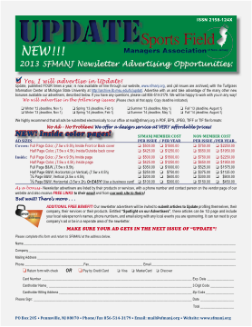
ADVERTISING
Big part of job is to maintain advertisers for Newsletter and Directory
and recruit new ones
Notes:
Advertising is a big source of our revenue
*
We use ad insertion form that I mail to all commercial members and to affiliated organizations
to recruit or renew ads for the newsletter
It is also available on website
*
I also solicit ads for the Member Directory that we publish each year
This is something I put together in September
*
In addition, I send Constant Contact Email blasts to get the message out.
Here is a form sent to our commercial members – with links
such as the link to the Turfgrass Information Center at Michigan State Univ. where all past issues of our Newsletters are archived
and to a “Click here” to download the ad insertion form

Slide 6
NEWSLETTER ADVERTISERS
Excel helps keep the list of newsletter advertisers to to date
Notes:
I keep track of our newsletter advertisers on an Excel spread sheet
*
With the info I can send email or Constant Contact
I have their street addresses for mail
But I also CALL contacts
By the way, the chapter phone is in my home office and all calls and faxes come in to me and they are all followed up on.
So very often I will call a company who, I know, will renew their ad, only to have them say “Oh yeah, I meant to send that form in to you. I’ll get it out right away”.
So calling and actually speaking to your contacts is very important.

Slide 7
NEWSLETTER
I am responsible for the design, layout and distribution of our newsletter, Update
Notes:
I am responsible for the design, layout and distribution of our newsletter, Update
*
I make sure our newsletter looks professional.
This is what I do, having a graphics background
If you don’t have a good layout person, find one
and have your administrator and/or editor work closely with them
The mailing list for the newsletter comes from our Excel spread sheet.
I get the content from Brad Park, our editor, who is great at estimating how much space we have for copy.
But, because I go to the board mtgs., when I’m putting the newsletter together I can fill in little spots
– Like “Save the Date” blurbs
or send us your email address or I can put in a small ad promoting our field of the year contest
*
Or a nice, big picture of our illustrious president, Matt Olivi – This one was taken at our spring field day.
After Brad gives the OK, it gets sent to the printer
I make sure we are getting a quality product, mailed first class by the printer - and for a great price.
325 issues - $589.00
Postage $247.63
Total – $836.63

Slide 8
COMMUNICATIONS
I am responsible for any communication to members, potential members and vendors, etc.
Notes:
I use all means possible to communicated with our members and/or business contacts
*
Constant Contact - $357/year- unlimited email blasts. Like I said, very easy to use. It’s like mini web pages.
This site also has templates
I monitor the chapter PO Box at the post office, so I not only receive the mail, but send a lot out.
* * *
These forms were mailed, AND emailed AND also made available on the web site
So, as you can see, I use any and all means of communication possible:
mail – email – Constant Contact – newsletter – web site
I’m not afraid to take the time to make that PHONE CALL
Especially to someone who I know will participate.

Slide 9
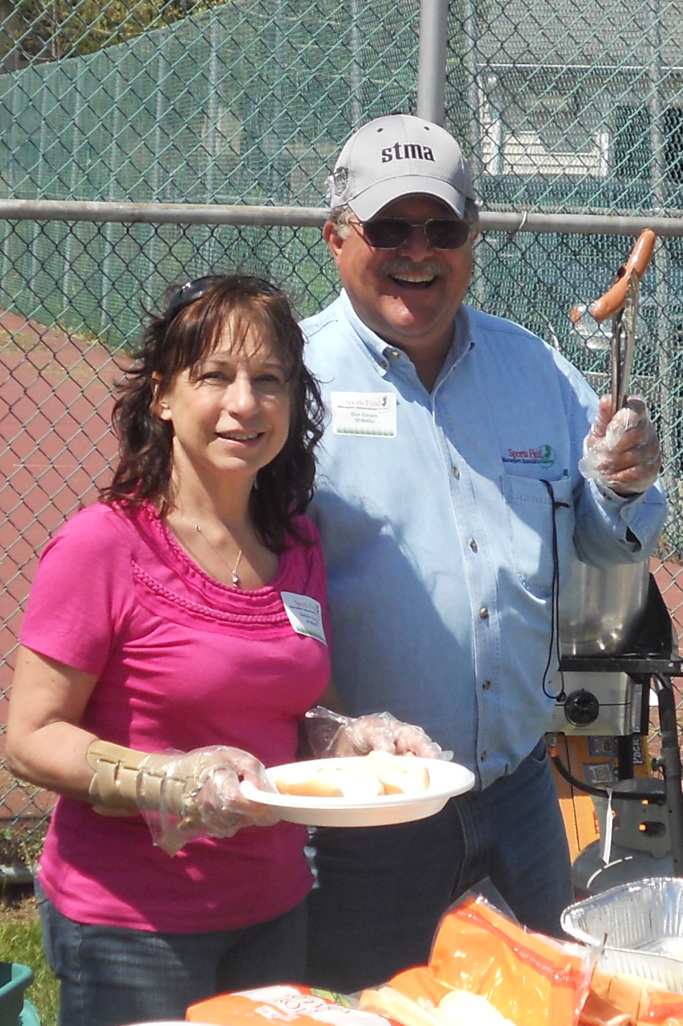
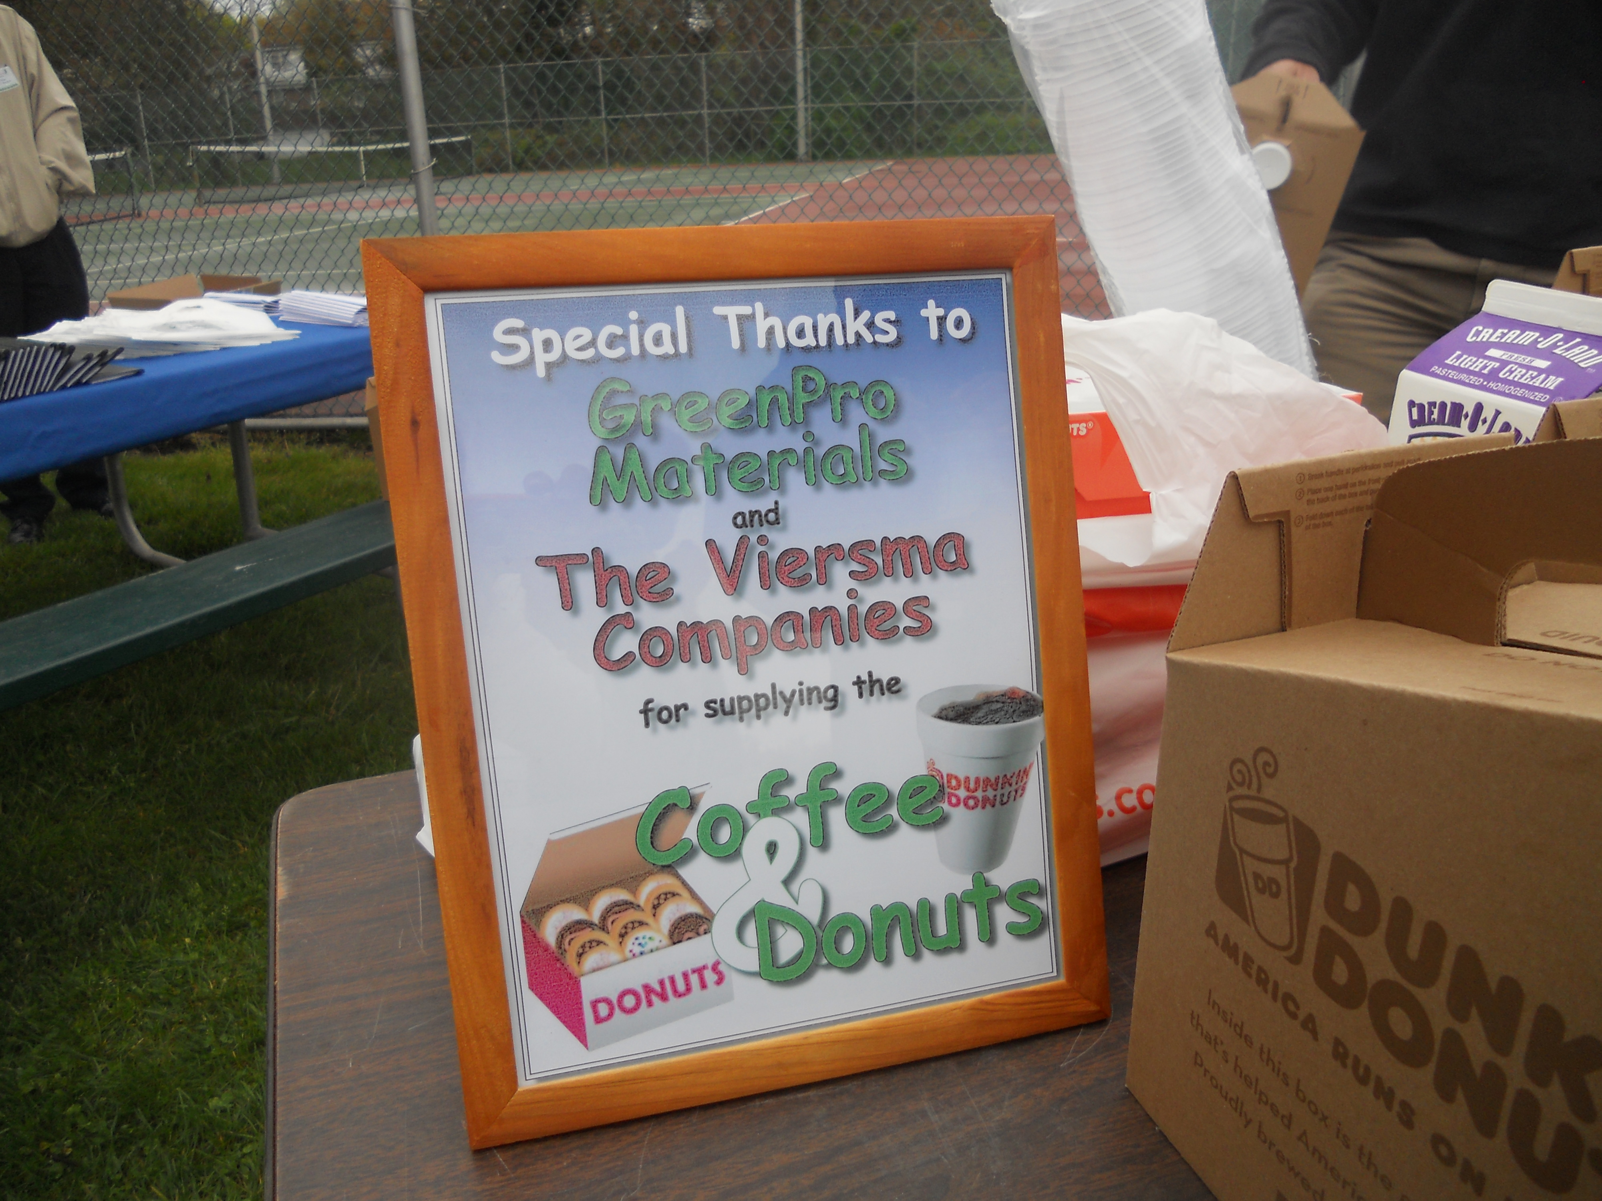
EVENTS
Promote,
Pre-register,
Attend events
Notes:
I promote events
I mail and/or email invitations, information and reminders (it’s very important that you follow up)
I pre register attendees and vendors
sometimes we register people with just a phone call, so I need to handle those as well
Then I attend the events to register participants on site - Like I said, attending events in part of my job
*
After that, I help out where needed –
This is our Spring 2012 Field Day and I’m serving lunch, Dirty Water Dogs that my husband, Don cooked up.
We moved away from boxed lunches because we felt this was more economical - and a lot more fun.
*
I photograph event – Along with Brad Park, our Newsletter editor
Either Brad’s photos or my photos or a combo of the two can end up in the newsletter
In general, I do what I can to help things run smoothly
*
I do the little things like keep event signage up to date
And this year we printed Banners - 4imprint.com
I got a great deal on these and the quality is wonderful – They also has templates you can use
But any idea I come up with, I run by the Board

Slide 10
WEB SITE
I am responsible for design and maintenance of our website:
www.sfmanj.org
Notes:
I am responsible for design and maintenance of our website:
www.sfmanj.org
*
This is our home page
*
The Contact Us page hopefully doesn’t change very often.
It lists the board members and has links to their email
*
I update the Events page after each event and change our Calendar of coming events as needed
*
Our Vendor page requires keeping our list of vendors up to date. Our advertisers printed in red.
Advertisers are also listed on the left under their specialty with a link to their website
Note that all pages have a link to our membership registration form and the advertisers contract
*
I also update our Resources page where we have listed past issues of the newsletter and minutes from the Board Meetings
Scott, our secretary, takes minutes at Board Mtgs., but I may step in if he isn’t there
So this gets updated at least once a month.

Slide 11
facebook
I maintain current events on facebook
Notes:
I maintain current events on facebook
*
This was just after our December event at the NJ Green Expo
*
Recently I started placing a “Like us on facebook” button that I insert into our constant contact emails

Slide 12
ACCOUNTS PAYABLE AND RECEIVABLE
Pay for purchases and invoices with SFMANJ credit card
Vouchers
Bill for dues, trade show booths and demos, advertising, etc. and collect money
Deposit Records
Notes:
Imagine if your treasurer had to keep track of every penny going in and out on a daily basis? Ours has his own business to run.
*
So for the most part, I handle the day to day purchases and payments with the SFMANJ credit card
*
And make a voucher for each one.
*
Here you see the charges for printing and postage for the newsletter broken out so the treasurer can add these to his spread sheet in the proper category
*
I bill for dues, trade shows etc. and payments are sent to our P.O. Box, which I collect.
*
and enter them on a deposit slip, after which I then make the bank deposit
*
He has these forms, which I forward to him,
but only has to enter the totals in the proper columns on his
spread sheets to create his budgets and reports.

Slide 13
Chapter Affiliation
I keep records and forward them to the STMA
Notes:
I keep records and forward them to the STMA
Everything’s in one spot
The board doesn’t have to ask:
* “Did anyone remember to send in the revision to the Bylaws?”
* Or “Did we file for our Annual Corporate report this year, who was going to do that?”
* Or “Gee, we haven’t sent in a current list of our Board of Directors for 5 years now”
Of course there are other documents, but I can take care of them, making sure nothing slips through

Slide 14
PROMOTIONAL ITEMS
For distribution at events
Notes:
We distribute promotional items at events, along with past extra issues of the newsletter
I am very fussy
But I’m also very Thrifty
I’m always looking for a great way to get a quality product for the least amount of money for our chapter.
*
Our 2013 calendar is a desk planner.
I was able to use a portion of a photo submitted by one of our field of the year contestants for the cover
*
We got soaked at one of our events this year, so we got the idea to print ponchos, which I got us for a great price and made sure they were printed properly
*
We also hand out pens at our events that I get printed when the supply runs low. This is a proof for this year’s pen.

Slide 15
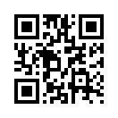
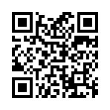
IDEA IMPLEMENTATION
Implement ideas talked about at Board Meetings
Credit Cards
Promotional Items
QR Codes
Quirify.com
Visualead.com
Notes:
How often are you in a meeting and an idea gets tossed around, but no one remembers to follow up on it?
Well I CAN follow up on these ideas. It’s my job.
So hopefully a lot of great things don’t get forgotten
*
I had the time to follow up on the credit card issue
We talked about having the ponchos at a mtg. So I did the research into finding a company to print those for us.
Then there’s the QR codes. We started talking about this when an advertiser placed an ad in the newsletter with a QR code in it.
I found out that they are very easy to make – and free to do!
I used a web site called:
Qurify.com
QR codes can open a web site, web page, document or just bring you a message
* *
Does anyone have a bar code or QR scanner on their phone?
*
Visualead.com
is a site where you can place QR codes into your logo or a photo or whatever.
I used this in the last newsletter just for fun
We are now using a QR code on most of our printing.

Slide 16
BENEFITS OF A PAID ADMINISTRATOR
Implement ideas and goals of the board
Free up board members time
Details don’t get lost in the shuffle
Pull things together
Day to Day jobs get done on time
Increased growth and revenue
Part time – 60 hours a month
Notes:
To sum things up:
Here’s some of the benefits of having me around.
I can follow up on ideas as well as do all of those pesky day to day chores, thus freeing up board members time.
Don’t want to burn them out
Lord knows that it is hard enough to recruit people who want to serve . . .
There’s one person doing the work instead of a lot of different people (or, in some cases, nobody)
keeping things from slipping through the cracks
Everything gets pulled together in one place
More attention can be paid to details
Like I said, I work part time
The cost is well worth it in the increased revenue to your chapter
Hopefully I’ve helped increase our membership, advertising and trade show
Our board of directors is a great group of guys who work hard to help the chapter grow. I’m happy that I can help out with the day to day administrative items
Having a paid administrator can only make your chapter stronger

Slide 17
THANK YOU
Notes:
Thank you for letting me be a part of your evening. We have some samples of our newsletter and other things on table. Feel free to help yourself.
I would be glad to answer any questions you may have.
I have my card available to those who want it or
You can find me on the STMA web site under the NJ chapter
And at our web site: sfmanj.org
There are many ways to get a hold of me, and I hope you will!
Thank you and I’ll just leave you with this
*

Slide 18
WHAT DO I DO?
Membership Recruitment, Retention, Invoicing
Advertizing Recruitment and Maintenance
Newsletter Layout, Design, Mailing
Member Communications Layout, Design, Printing
Field Day and Trade Show Promotion, Registration
Website Design and Maintenance
facebook page Maintenance
Constant Contact Communication
All Email Communication
Accounts Payable and Receivable
Chapter Affiliation Documents
Design and Printing of Promotional Materials
Maintain Files
Attend Events and Board Meetings
Have Rapport with Board of Directors
Know Vendors and Membership
Handle Chapter Phone Calls and Faxes
Handel Mailings and Correspondence
Handle Chapter Email

